Slide 1
Algoritma & Pemrograman
The Standard Class string
Prepared by
Frans Panduwinata, S.Kom, M.T

Slide 2
Initializing Strings
A string, that is, an object belonging to the string class, can be initialized using:
  a predefined string constant
  a certain number of characters
  a predefined string or part of a string.

Slide 3
Initializing Strings (cont)
If a string is not initialized explicitly, an empty string with a length of 0 is created.
The length of a string is stored internally and can be accessed using the length() method.
EXAMPLE:
string message("Good morning!");
cout << message.length(); // Output: 13

Slide 4
String Assignments
When you assign a value to a string, the current contents are replaced by a new character sequence.
You can assign the following to a string object:
  another string
  a string constant or
  a single character.
The memory space required is adjusted automatically.

Slide 5
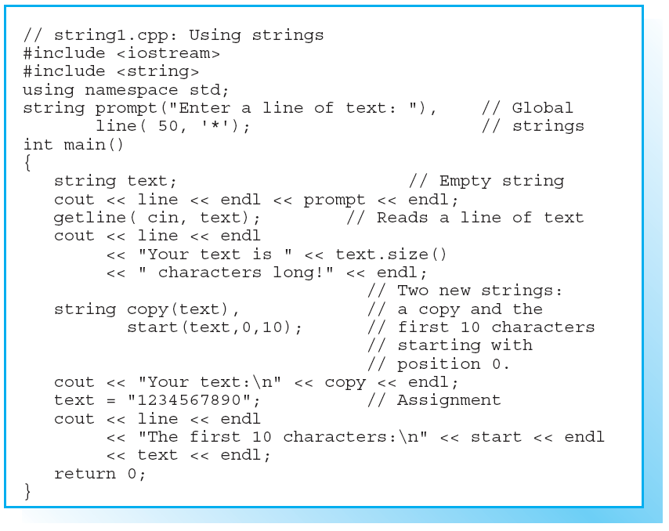
Sample Program

Slide 6
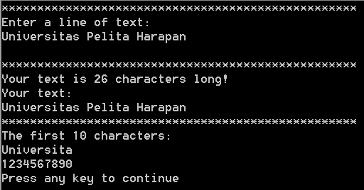
Sample Program (cont)
Screen Output:

Slide 7
Using + to Concatenate Strings
You can use the + operator to concatenate strings, that is, to join those strings together.
EXAMPLE:
string sum, s1("sun"), s2("flower");
sum = s2 + s3;
This example concatenates the strings s1 and s2. The result, "sunflower" is then assigned to sum.

Slide 8
Using + to Concatenate Strings (cont)
The expression of the string type can in turn be used as an operand in a more complex expression.
EXAMPLE:
string s1("sun"),s2("flower"),s3("seed");
cout << s1 + s2 + s3;
  Since the + operator has precedence over the << operator, the strings are concatenated before the “sum” is output.
  Concatenation takes place from left to right.

Slide 9
Using + to Concatenate Strings (cont)
String constants and single characters are also valid as operands in expressions containing strings:
EXAMPLE:
string s("Good morning ");
cout << s + "mister X" + '!';
At least one operand must be a string class object.
The expression "Good morning " + "mister X" would be invalid!

Slide 10
Using += to Concatenate Strings
Strings can also be concatenated by first performing concatenation and then assigning the result.
EXAMPLE:
string s1("Good "),s2("luck!");
s1 = s1 + s2; // To concatenate s2 and s1
This example creates a temporary object as a result of s1 + s2 and then assigns the result to s1.

Slide 11
Using += to Concatenate Strings (cont)
You can obtain the same result using the assignment operator += , which is far more efficient.
EXAMPLE:
s1 += s2; // To concatenate s2 and s1.
s1 += "luck!"; // Also possible
  This adds the content of the second string directly to s1.
  Thus, the += operator is preferable to a combination of the + and = operators.

Slide 12
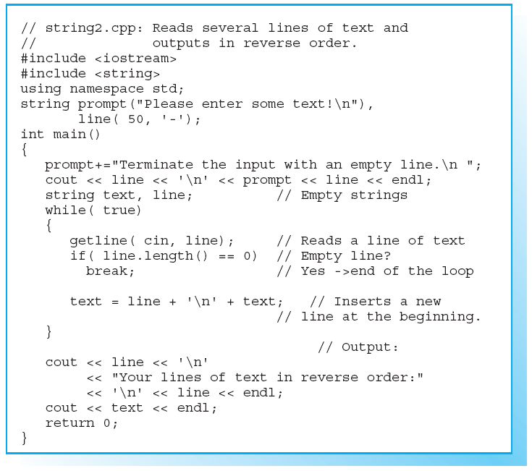
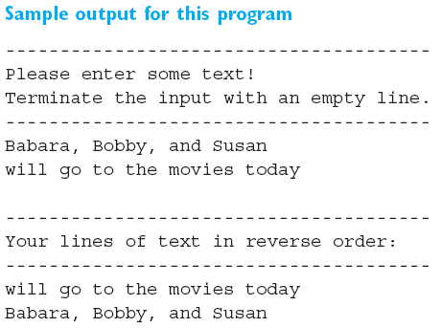
Sample Program

Slide 13
Results of Comparisons
Strings are compared lexicographically, that is character by character, beginning at the first character.
To decide whether a single character is smaller, greater, or identical to another character, the character codes of the character set are compared.
A comparison results in a bool type value.

Slide 14
Results of Comparisons (cont)
Given two strings s1 and s2:
  s1 == s2 is true only if
  both strings are identical; this requires that both strings are exactly the same length.
  s1 < s2 is true only if
  the first character in s1 that differs from the corresponding character in s2 is smaller than the corresponding character in s2, or if s2 is simply an extension of s1.

Slide 15
Results of Comparisons (cont)
In an expression comparing strings, one operand can again be a string constant or a single character.
EXAMPLE:
while( key == 'y' ) { . . . }
  This example compares the string key with the single character 'y'.
  This is an alternative method of expressing the comparison key == "y".

Slide 16
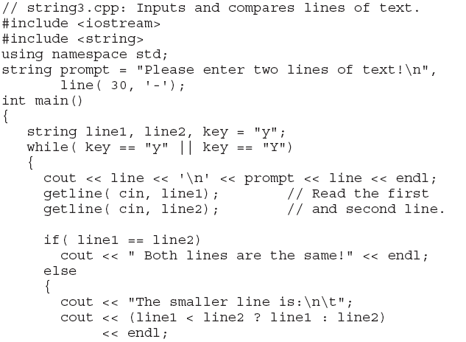
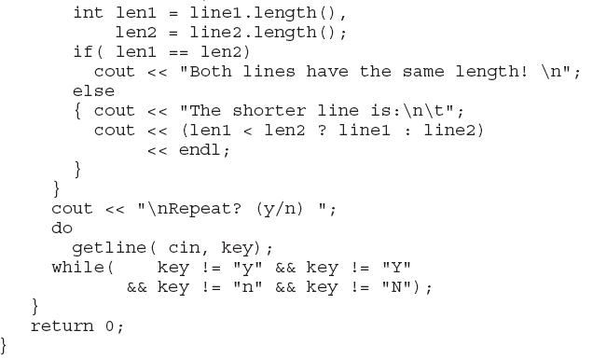
Sample Program

Slide 17
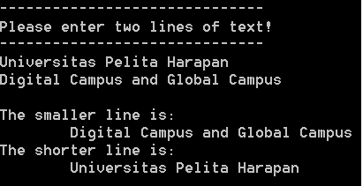
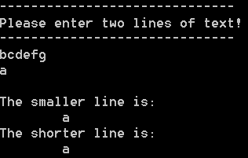
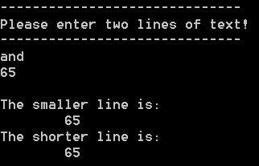
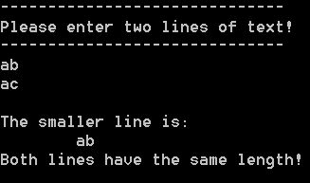
Sample Program (cont)
Screen Output:

Slide 18
Insertion
The method insert() inserts a string at a certain position of another string.
The position is passed as the first argument and defines the character before which to insert the string.
The first character in a string occupies position 0, the second character position 1,and so on.

Slide 19
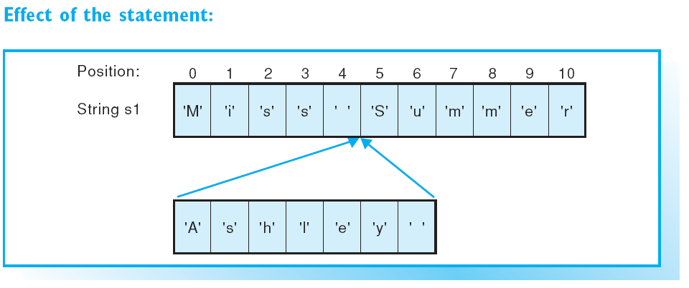
Insertion (cont)
EXAMPLE:
string s1("Miss Summer");
s1.insert(5, "Ashley ");
Following this, the string "Miss Ashley Summer" is assigned to s1.

Slide 20
Insertion (cont)
Pass two additional arguments to the insert() method, the starting position and the length of the string to insert only part of a string into another string.
EXAMPLE:
string s1("Ashley is a devil"),
s2(" sweetheart");
s1.insert(12, s2, 1, 10);
  This example inserts the first 10 characters from the string s2 at position 12 in string s1.
  String s1 then contains the string “Ashley is a sweetheartdevil".

Slide 21
Erasing
You can use the erase() method to delete a given number of characters from a string.
The starting position is supplied as the first argument and the number of characters to be erased is the second argument.

Slide 22
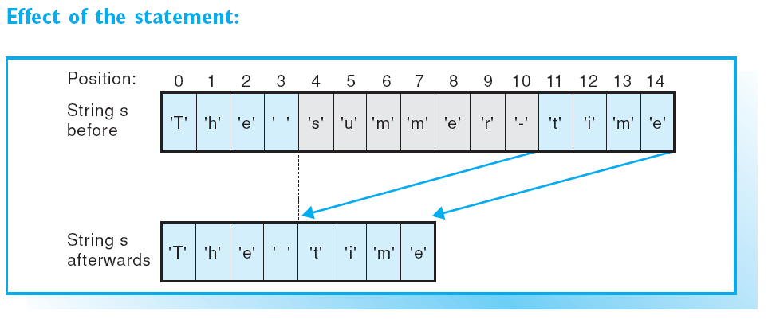
Erasing (cont)
EXAMPLE:
string s("The summer-time");
s.erase(4,7);
This statement deletes 7 characters from string s starting at position 4.

Slide 23
Erasing (cont)
The erase() method can also be called without specifying a length and will then delete all the characters in the string up to the end of the string.
EXAMPLE:
string s("winter-story");
s.erase(6); // s now contains "winter“
You can also call erase() without any arguments to delete all the characters in a string.

Slide 24
Searching
The find() method returns the position at which a substring was first found in the string.
The method requires the substring to be located as an argument.
EXAMPLE:
string youth("Bill is so young, so young");
int first = youth.find("young");
The variable first has a value of 11 in this example.

Slide 25
Searching (cont)
You can use the “right find” method rfind() to locate the last occurrence of a substring in a string..
EXAMPLE:
int last = youth.rfind("young");
This initializes the variable last with a value of 21 in our example

Slide 26
Replacing
When replacing in strings, a string overwrites a substring.
The string lengths need not be identical.
You can use the replace() method to perform this operation.
  The first two arguments supply the starting position and the length of the substring to be replaced.
  The third argument contains the replacement string.

Slide 27
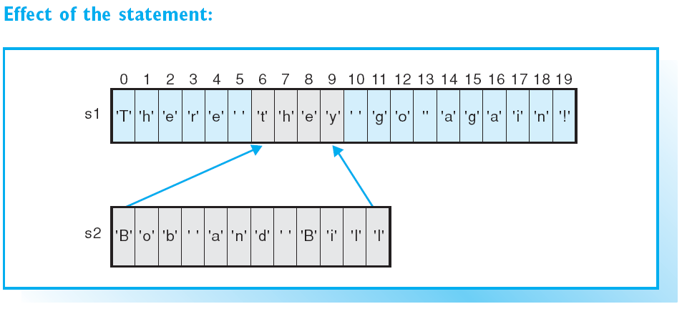
Replacing (cont)
EXAMPLE:
string s1("There they go again!"), s2("Bob and Bill");
s1.replace(6, 4, s2);

Slide 28
Replacing (cont)
Use the fourth argument to define the starting position and the fifth to define the length of the substring If you only need to insert part of a string.

Slide 29
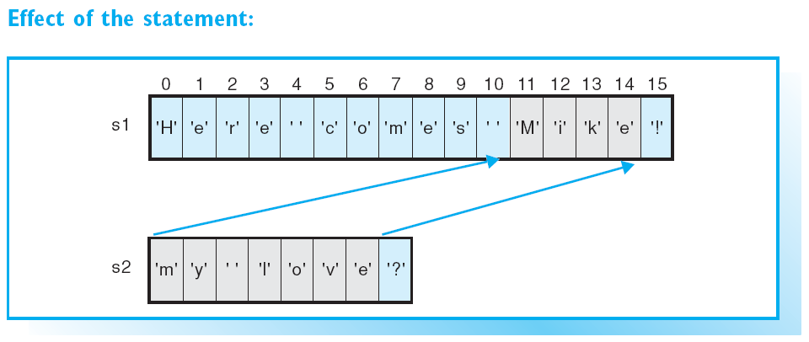
Replacing (cont)
EXAMPLE:
string s1("Here comes Mike!"), s2("my love?");
s1.replace(11, 4, s2, 0, 7);

Slide 30
Subscript Operator
The easiest way to access a single character in the string is to use the subscript operator [ ].
EXAMPLE:
string s = "Let";
the individual characters in the string are:
s[0] == 'L', s[1] == 'e', s[2] == 't'
The last character in a string always has an index of s.length() – 1.

Slide 31
Subscript Operator (cont)
You can use the subscript operator to read any character in a string and also to overwrite a character.
EXAMPLE:
char c = s[0];
This statement copies the first character from s to the variable c.
In contrast
EXAMPLE:
s[s.length() –1] = 'g';
overwrites the last character in the string s. Following this, s will contain the string "Leg".

Slide 32
Invalid Indices
Any integral expression can be used as an index.
However, no error message occurs if the boundaries of a valid index are overstepped.
EXAMPLE:
cout << s[5]; // Error
Your program’s reaction to an invalid index is undefined; this requires careful attention by the programmer!

Slide 33
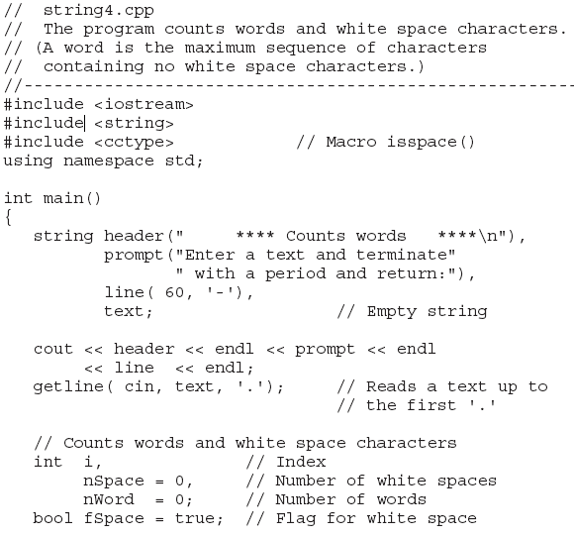
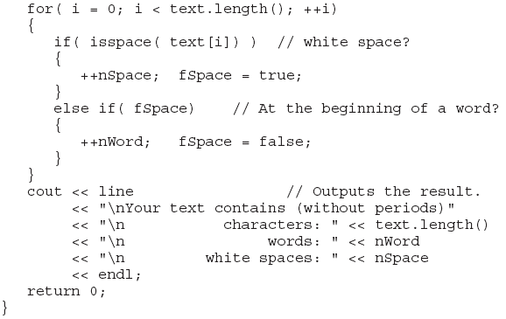
Sample Program

Slide 34
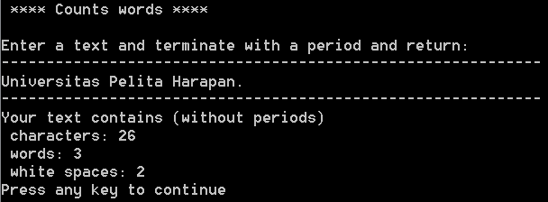
Sample Program (cont)
Screen Output:

Slide 35
Exercises
EXERCISE 1
Write a C++ program to
  Initialize a string s1 with the string "As time by ..." and a second string s2 with the string "goes",
  insert string s2 in front of "by" in string s1,
  erase the remainder of string s1 after the substring "by",
  replace the substring "time" in s1 with "Bill".
In each case, your program should determine the position of the substring.
Output string s1 on screen at the beginning of the program and after every modification.

Slide 36
Exercises (cont)
EXERCISE 2
Write a C++ program that reads a word from the keyboard, stores it in a string,and checks whether the word is a palindrome.
A palindrome reads the same from left to right as from right to left.
EXAMPLES:
“OTTO, ” “deed, ” and “level.”
Use the subscript operator [ ].

